Slide 1
Kaizen
A STRATEGY LEAN MANAGEMENT FOR
PERFORMANCE
EXCELLENCE
S. Lakshmanaraj
Jun 24, 2011

Slide 2
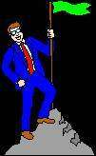
What Does Kaizen Mean?
KAI ZEN
To modify, to change Think, make good, make better
= KAIZEN
Make it easier by identifying it and making the improvements through elimination of waste and human interactions.
+

Slide 3

Kaizen – Continuous Improvement
Is the continuous elimination of wastes to retain and increase values, elimination of repetitive human tasks to automated machine tasks and transforming difficult tasks to easy tasks through innovation
Automate Repetition
Eliminate Waste
Make it Easy
Leadership
Improvement
Kaizen
Measurement
MURA : Evenly distribute workload and Automate the repetitive tasks
MUDA : Eliminate Redundant or duplicate Process and which did not give value or give hurdle to improvement
MURI : Innovate Ideas to overcome difficult tasks and continuously again integrate and improve 3 MUs

Slide 4
When the delivery lead-time is bigger than the Coding and Testing (manufacturing) lead time:
This is Ideal life!
But not, it’s torture…
Delivery lead time
Coding & Testing (Manufacturing) lead time
Delivery lead time
Coding & Testing (Manufacturing) lead time

Slide 5

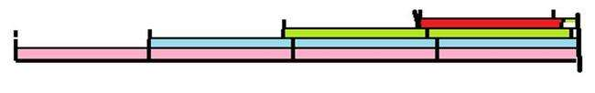
What is the solution?
False Immediate solution: Deliver equally every release
Kaizen Solution: Deliver incrementally every release
Delivery lead time
Coding & testing (Manufacturing) lead time
Generate instability and more support stocks
Delivery lead time
Generate Stability and More values
Coding & Testing (Manufacturing) lead time
Notes:
Creating excess inventory and warehousing of finished goods masks the root cause: wastes in manufacturing.
Our highest priority is to satisfy the customer through early and continuous delivery of valuable product.
Welcome changing requirements, even late in development. Agile processes harness change for the customer's competitive advantage.
Deliver working product frequently, from a couple of weeks to a couple of months, with a preference to the shorter timescale.
Business people and developers must work together daily throughout the project.
Build projects around motivated individuals. Give them the environment and support they need, and trust them to get the job done.
The most efficient and effective method of conveying information to and within a development team is face-to-face conversation.
Working product is the primary measure of progress.
Agile processes promote sustainable development. The management, developers, and users should be able to maintain a constant pace indefinitely.
Continuous attention to technical excellence and good design enhances agility.
Simplicity--the art of maximizing the amount of work not done--is essential.
The best architectures, requirements, and designs emerge from self-organizing teams.
At regular intervals, the team reflects on how to become more effective, then tunes and adjusts its behavior accordingly.

Slide 6
Apply 3 MUs in 5 S
(To Sort )/Do a sequencing and prioritizing Tasks
Eliminate what’s not absolutely necessary.
(To Straighten) / To Set In Order / To Allocate and Distribute Tasks
Ensure space for each thing, and a thing for each space. No more searching.
To Sustain : This is a way of life.
Learn continuously and do without being told. Take proactive steps and preventative measures.
(To Sanitize) / To Standardize / To Look in for Health of Portfolios
Improve Dashboards. Be organized. No need to reinvent wheels, but innovate through brainstorming and group discussions
(To Sweep) / To Shine / To Re-factor / To Archive and To Enhance 6 Ms (Man, Machine, Material, Method, Measurement and Money)
Maintain a clean and orderly space to make problems easily identifiable. Eliminate rejects and scrap.
The 5 S
+Safety 6 S
Notes:
All conditions existing in the workplace that act to complicate or impede efficiency in meeting desired product or service requirements are the focus of improvement. This includes housekeeping, the 5 steps of which are diagrammed above.
Rocks In a Jar
One day an expert in time management was speaking to a group of business students and, to drive home a point, used a illustration those students will never forget.
As he stood in front of the group of high powered overachievers he said, "Okay, time for a quiz." Then he pulled out a one-gallon, wide mouthed Mason jar and set it on the table in front of him. Then he produced about a dozen fist-sized rocks and carefully placed them, one at a time, into the jar.
When the jar was filled to the top and no more rocks would fit inside, he asked, "Is this jar full?“
Everyone in the class said, "Yes." Then he said, "Really?" He reached under the table and pulled out a bucket of gravel. Then he dumped some gravel in and shook the jar causing pieces of gravel to work themselves down into the space between the big rocks.
Then he asked the group once more, "Is the jar full?" By this time the class was on to him. "Probably not," one of them answered. "Good!" he replied. He reached under the table and brought out a bucket of sand. He started dumping the sand in the jar and it went into all of the spaces left between the rocks and the gravel.
Once more he asked the question, "Is this jar full?" "No!" the class shouted. Once again he said, "Good." Then he grabbed a pitcher of water and began to pour it in until the jar was filled to the brim.
Then he looked at the class and asked, "What is the point of this illustration?"
One eager beaver raised his hand and said, "The point is, no matter how full your schedule is, if you try really hard you can always fit some more things in it!"
"No," the speaker replied, "that's not the point. The truth this illustration teaches us is: If you don't put the big rocks in first, you'll never get them in at all."
What are the 'big rocks' in your life? Your children.... Your loved ones.... Your education.... Your dreams... A worthy cause.... Teaching or mentoring others.... Doing things that you love.... Time for yourself.... Your health.... Your significant other.
Remember to put these BIG ROCKS in first or you'll never get them in at all.
If you sweat the little stuff (the gravel, the sand) then you'll fill your life with little things you worry about that don't really matter, and you'll never have the real quality time you need to spend on
the big, important stuff (the big rocks). So, tonight, or in the morning, when you are reflecting on this short story, ask yourself this question: What are the 'big rocks' in my life? Then, put those in your jar first.

Slide 7

Identify 9 Areas to Apply 5S in 3 MUs
Think Break
Excessive Processing: Redundant and unnecessary process steps, excess processing, excess checking and inspection. Excess use of energy of all types.
Correction (Defects): Re-do’s, fix-ups, returns, mark-downs, managing complaints.
Frequent / Multiple versions of Releases un hope to test full coverage leading to residual issues (Over Production Storage, Meet customer requirements, Pull production from Customer demand)
Waiting Delays and Search Time (Movement): Time spent looking for information, people, supplies, and equipment. Also Miscommunication, Misinformation, Fear to Exchange Knowledge (Motions, Empower workers)
Load balancing, Configuration Items from One Stage to Another Stage (Transportation)
Difficult Process and Complexity: Complex process flows. Confusing product and service choices. Organizational boundaries, which introduce inefficiencies and frustrate any sense of accomplishment (Do the right the first time, Design for rapid change over)
Re-Inventing Wheels and not exchanging Re-usability (Minimize Inventories and Maximize flow, Partner with Suppliers)
Existing / Producing Defective Products Maintenance Management and Corrective, Preventative action Management (Eliminate Waste, Create a culture of continuous improvement)
Untapped Resources as well as Misused / Unmotivated Resources
Notes:
Exercise objectives:
Use the 9 waste definitions as applied to the participants workplace
Apply the “5 Whys” approach to identifying possible root causes
Brainstorm solution possibilities
Identify potential follow-up measures of solution effectiveness
Downtime:
• Defects rework: Repeating blood tests due to specimen mislabeling, medication errors (wrong dosage), non-compliance with agreed practice D
•Overproduction: Ordering of X-ray daily in ICU, mixing drugs in advance, hourly monitoring of patient when not required, printing of sticky labels before patients’ admission O
•Waiting: Doctor waiting for mobile X-ray at OT, waiting to be discharged, waiting for bed assignments, waiting for treatment, waiting for diagnostic tests, waiting for approval, waiting for supplies, waiting for doctor/nurse W
•Not using staff talents: Supervisors giving solutions without discussing with staff, nurses couriering routine samples to lab, nurses collecting medicines from pharmacy, nurses taking phone calls which can be dealt with by AO N
•Transportation: Retrieval of notes from another place, movement of required equipment or supplies from another place T
•Inventory: Stocking of unnecessary supplies, lab specimens awaiting analysis, over ordering supplies even if enough stock, stock obsolete items, insufficient stock I
•Motion: Doctor walking back and forth to look for KY jelly (lubricant), nurses looking for case notes and supplies, doctors rounding in different wards/buildings because of overflow, delivering medicines M
•Excessive processing: Asking patients repeatedly for same info, duplication of paperwork, redundant processes (repeated faxing as a form of communication), repeating lab tests unnecessarily, repeat phone calls to clarify information E
These are the eight wastes, which can be remembered with the mnemonic TIM WOODS. 1. Transport – waste transport refers to the excess movement of the product, patient/service user or medical records, supplies and equipment through the process. Some amount of transportation will be necessary depending on hospital or clinic layouts – but ask yourself, “Have we optimised or minimised transportation?” This is where spaghetti diagrams can be particularly useful. Your service redesign could take patient/service user walking distances into account. 2. Inventory – wasteful inventory is usually excessive inventory – deﬁned as having more of a particular item than is needed to perform the process. Excess inventories tie up resources – hospital cash is used to pay for these materials that sit in store cupboards. Often we spend additional money to store these items – shelving, etc. As inventories grow so the space required to store them increases – and this may mean that material has to be stored remotely from the point of use – this in turn can lead to additional transportation waste.
Large inventories also have the effect of hiding out-of-date and obsolescent material. In one south west NHS trust, a review of the haematology inventories revealed 17 boxes of thermal printing paper, even though the department no longer used a thermal printer! This excess inventory was purchased to take advantage of lower bulk prices - which proved more expensive as actual usage was not considered. The primary consideration here is customer and patient/service user needs – but we aim to meet those needs with the lowest possible inventory levels. Remember that although too much inventory wastes space and ﬁnancial resources, running out of an item can lead to additional motion, transportation, costs and also the additional expedition required. In a lean and efﬁcient process, we aim for the right level of supplies and inventory close to the point of use – ensuring that patient/service user care can be delivered. 3. Motion – while transportation considers the movement of the product or patient/service user, the waste of motion refers to employees. Service re-design should aim to reduce or eliminate the extra motion that poor system design often creates. A system with optimal motion reduces employee fatigue and frees up valuable time to focus on the value add activities within our processes. Often in a healthcare environment the wasted motion is walking. It may well be considered ‘part of the job’ – but it is very rarely a value add activity. Does the amount of walking you have to do add value from the patient/service user perspective? Walking waste can often be addressed by improving the layout of work areas and the location of supplies and equipment. Other forms of waste motion could be stretching or reaching. 4. Waiting – waiting refers to those points in the process where nothing is happening – no value is being added. Patient/service user waiting rooms is one obvious example – often due to poor ﬂow (see ﬂow – reduce unnecessary waits) or scheduling. Racks of histology specimens waiting for diagnosis, or surgical instruments waiting to be sterilised are other examples – often due to batching of work and no consideration of FIFO (ﬁrst in ﬁrst out) planning. 5. Over production – this is waste where an excess of a product or service is being created without there being any need for them. Examples may include patient/service user meals, IT reporting or pharmacy medications for patients/service users who have already been discharged. 6. Over processing – doing unnecessary work or work to a higher quality than the customer requires. 7. Defects – any work activities not done ‘right ﬁrst time’. 8. Skills – not using people to the best of their abilities. One example could be bed managers acting as porters, but can also be created through not engaging employees or listening to their ideas.
Eliminate waste.
Minimize inventory.
Maximize flow.
Pull production from customer demand.
Meet customer requirements.
Do it right the first time.
Empower workers.
Design for rapid changeover.
Partner with suppliers.
Create a culture of continuous improvement.
To measure financial performance:
1. Net Profit
2. Net Profit Margin
3. Gross Profit Margin
4. Operating Profit Margin
5. EBITDA
6. Revenue Growth Rate
7. Total Shareholder Return (TSR)
8. Economic Value Added (EVA)
9. Return on Investment (ROI)
10. Return on Capital Employed (ROCE)
11. Return on Assets (ROA)
12. Return on Equity (ROE)
13. Debt-to-Equity (D/E) Ratio
14. Cash Conversion Cycle (CCC)
15. Working Capital Ratio
16. Operating Expense Ratio (OER)
17. CAPEX to Sales Ratio
18. Price Earnings Ratio (P/E Ratio)
To understand your customers:
19. Net Promoter Score (NPS)
20. Customer Retention Rate
21. Customer Satisfaction Index
22. Customer Profitability Score
23. Customer Lifetime Value
24. Customer Turnover Rate
25. Customer Engagement
26. Customer Complaints
To gauge your market and marketing efforts:
27. Market Growth Rate
28. Market Share
29. Brand Equity
30. Cost per Lead
31. Conversion Rate
32. Search Engine Rankings (by keyword) and click-through rate
33. Page Views and Bounce Rate
34. Customer Online Engagement Level
35. Online Share of Voice (OSOV)
36. Social Networking Footprint
37. Klout Score
To measure your operational performance:
38. Six Sigma Level
39. Capacity Utilisation Rate (CUR)
40. Process Waste Level
41. Order Fulfilment Cycle Time
42. Delivery In Full, On Time (DIFOT) Rate
43. Inventory Shrinkage Rate (ISR)
44. Project Schedule Variance (PSV)
45. Project Cost Variance (PCV)
46. Earned Value (EV) Metric
47. Innovation Pipeline Strength (IPS)
48. Return on Innovation Investment (ROI2)
49. Time to Market
50. First Pass Yield (FPY)
51. Rework Level
52. Quality Index
53. Overall Equipment Effectiveness (OEE)
54. Process or Machine Downtime Level
55. First Contact Resolution (FCR)
To understand your employees and their performance:
56. Human Capital Value Added (HCVA)
57. Revenue Per Employee
58. Employee Satisfaction Index
59. Employee Engagement Level
60. Staff Advocacy Score
61. Employee Churn Rate
62. Average Employee Tenure
63. Absenteeism Bradford Factor
64. 360-Degree Feedback Score
65. Salary Competitiveness Ratio (SCR)
66. Time to Hire
67. Training Return on Investment
To measure your environmental and social sustainability performance:
68. Carbon Footprint
69. Water Footprint
70. Energy Consumption
71. Saving Levels Due to Conservation and Improvement Efforts
72. Supply Chain Miles
73. Waste Reduction Rate
74. Waste Recycling Rate
75. Product Recycling Rate

Slide 8
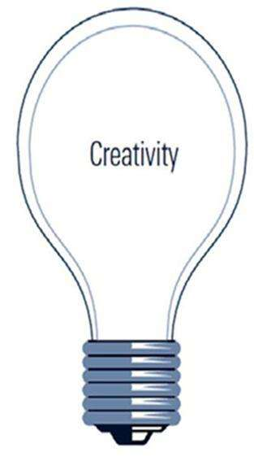
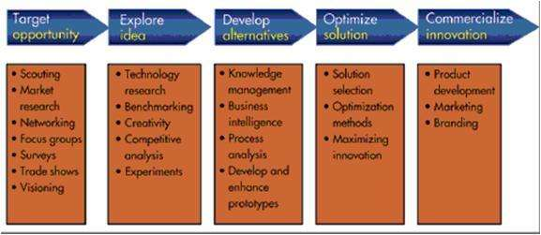
Act by 11 Methods to identify as well as identified 3 MU items of each 9 areas to every 5S application
Brainstorming
Easier
Faster
More with Less
Longevity
Durability
Protection
Sustaining
Learning
Entertaining
Life Saving
Prediction
Prescription
Decision making
Less Intervention
Eco friendly
Simulation
Synectics
Normal Grouping
Consensus Mapping
The Delphi Technique
Expectations and Needs
Innovation
Biomimetics
Challenging Orthodoxies
Harnessing Trends
Leveraging Resources
Best Practices

Slide 9
11 Seeking Creativity Methods to Innovate
Brainstorming : Process of suggesting many possible alternatives without evaluation. (War room session)
Synectics : Process of generating novel alternatives through role playing and fantasizing. (6 Thinking Hats, 21 pairs of 6 Action Shoes)
Nominal Grouping : Process of generating and evaluating alternatives using a structured voting method that includes listing, recording, clarification, ranking, discussion, and voting to select an alternative. (Stop ready go Dare rank method)
Consensus Mapping : Process of developing group agreement on a solution to a problem. (Ringi Kepner Tregoe Decision System)
Delphi Technique : Process of using a series of questionnaires to refine a solution. (4W + 2H & 5 Why Questions)
Expectations and Needs Fulfillment : Process of fulfilling expectations and needs of current or future to the self or home or organization or customers or world (SCAMPER), What are the unmet needs and frustrations that everyone else is simply ignoring?
Biomimetics : Process of trying to mimic or improving nature
Challenging Orthodoxies : Process of challenging that if the dominant conventions in your field, market, or industry are outdated, unnecessary, or just plain wrong
Harnessing Trends : Process of the shifts and discontinuities that will, now and in the future, provide the energy you need for a major leap forward
Leveraging Resources : Process of arranging existing skills and assets into new combinations that add up to more than the sum of their parts
Best Practices : Process of implementing known proven best practices used by other similar business industries (7 old QC Tools, 7 New QC Tools)

Slide 10
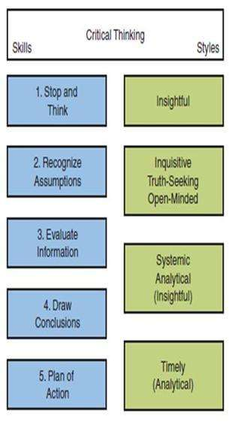
Brain Storming
Gossip with the “Discipline”
Give room for Both Lateral & Critical Thinking
Critical thinking
Generative thinking helps you to seek alternative ideas to problems; Analyze challenges; Challenge assumptions; Reword problems; Think in Reverse; Connect the Unconnected; Incubate, Illustrate Storyboarding
Reactive thinking is after something or anticipating risks and how to react or prevent through Group discussion
Analytical thinking is done by way of models such as SWOT analysis, PEST/PESTLE analysis, 4Ps to 7 Ps
Selective thinking is the process whereby one selects out favorable evidence for remembrance and focus, while ignoring unfavorable evidence for a belief
Proactive thinking is to make choices after considering and thinking other people’s views; priorities; objectives; alternatives; consequences; guessing; decisions; conflict-resolution and creativity; Express yourself through different medias
Notes:
PESTLE : Politics, Economy, Social, Technology, Legal and Environment
4Ps to 7Ps : Product, Price, Place, Promotion, People(Public opinion, Politics Influence), Process, Physical Presence

Slide 11
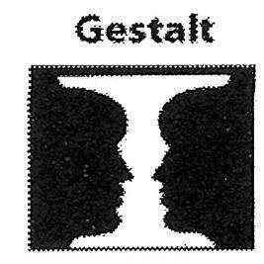
Brain Storming
Lateral thinking
Seeking ways to solve problems by apparently other than critical thinking such as illogical means
Seek different dimensions; Combine two or more topics
Shift perspective; Use random Inputs; Create Fun and humor;
Change Environment; Shutting out distractions; Create Silences; Give Pauses;
Look for Plus, Minus, Interesting;
Dig more on Agreement, Relevance and Oppositions
Re-think the research directions;
Seek Other peoples View; Play if I were;
Use powerful tools, find suitable to solve problems
Consider All factors; Think Consequence & Sequel
Add an appropriate adjective
Never criticize any opinion
State your own opinion freely
Don’t Hesitate to Expand other’s ideas and Capitalize on them
Evaluate ideas quantitatively after session (How it can help reducing cycle time, effort, human interactions, increasing profit, quality, performance)
Don’t take more than 1 hr

Slide 12
Six Thinking Hats
An intuitive way to keep your thoughts focused while problem solving in following sequence of findings Except the Last.
Red hat
Spell out to others emotions, gut instincts, intuition, and feelings.
Accept yours and your team emotions, gut instincts, intuition, and feelings. (Variation: Some follows Green or Black hat to 2nd due to thinking differently twice)
White hat—get data, information, emotionally neutral.
Green hat—represents creativity, new ideas, alternatives, and possibilities.
Yellow hat—represents sunny, optimistic, and positive thinking.
Black hat—represents careful and analytical thinking for what if negatives.
Blue hat—represents coordination, control, and the discipline to know when to use which hat.
Notes:
The Steps
Blue Hat the controller will take in charge as following
1. State the Problem
“I don't know how to put this, but it looks like we can't seem to get along.
“It's obvious you and I don't have a very good relationship.
“This is impacting both of us.
“I'm trying to be reasonable. I realize there are two sides to every story.
2. Ask questions to draw out the other side's story. Then wait.
“I appreciate your honesty.
“I'd like to know how you see it. I'd like to hear your side of the story.
“How is your system set-up?
“I need you to tell me. What do you think?
3. Keep asking instead of jumping to conclusions and solutions.
“What where you going to say? Please, go on. “I'd really like to know.
“I didn't realize ...; “That could be a hassle. “Go on.
“I want to make sure I fully understand the situation, the whole picture.
“Is there anything else? You look like you're holding something back.
4. Listen to paraphrase other's point of view. Don't interrupt. Don't argue.
“I'm glad you're telling me this. “This really helps me.
“So I create problems for you when I ...;
“Not:“That's not true ...; “As a matter of fact ...;
“Not:“If you weren't so ...; (stubborn, egotistical, etc. defensiveness)
5. Analyze specific situations rather than threatening or getting defensive.
Let's call this a no-fault discussion. “Let's take this one step at a time.
Not:“Every time ...; “You never ...; “We always ...;
“Can you give me an example? “How often does that happen?
“When I (ask you, give you, etc.) ...; what happens?
6. Ask permission before telling your side of the story.
“Would you like to hear how I see it? “Could you help me with my situation?
“When I ...; what happens is ...; ? “The problem with this is that ...; “I feel like I'm ...
“How do you feel about what I just said?
7. Get agreement the issues and why it is valued.
“So, it's a problem for you when I ...; “This is important to you because ...;
“And I have a difficult time when you ...; “This is important to me because ...;
“Could we say that's our basic problem?
8. Brainstorm (Write down) specific possible solutions — one at a time.
“Can we work together to come up with some ideas we can both live with?
“What if we tried ...; “Have we considered ...; “Could we perhaps ...;
“Let's write down all these good ideas so we won't forget. “Let's take it one idea at a time.
9. Agree on the best actions and measures of progress.
“What will we need to see before we can say that this is getting better?
“Would this make things better? “Would this solve our problem? “Would this work?
“Would it cause a problem if we ...;“I am worried that if we do that ...;
10. Take Action and Follow-up as agreed. Track results over time.
“So, from now on, we'll ...; “To do your job, you would like ...; “To do my job I would like ...;
“And if we catch each other not doing what we've agreed, what can we do to remind each other?
“Let's check back with each other every ...;

Slide 13
21 Pairs of Six Action Shoes
Puts the emphasis on action or operation rather than only thinking on concerned with what is about to be done Any team can have not more than 2 pairs of shoes at a time to act
Navy formal shoes - Routines and formal procedures
Grey sneakers - Exploration, investigation, and collection of evidence - Purpose of the action is to get information
Brown brogues - Involves practically and pragmatism, Do what is sensible and what is practical, Figure it out as you go using initiative, practical behavior, and flexibility - Almost the opposite of the formality navy formal shoes
Orange gumboots - Danger and emergency, Safety and Reputations are the prime concerns
Pink slippers - Suggest care, compassion, and attention to human feelings and sensitivities
Purple riding boots - Suggest authority, Playing out the role give by virtue of a position or authority, There is an element of leadership and command, The person is not acting in his or her own capacity but in an official role

Slide 14
Stop Ready GO DARE Rank Method
To determine the degree of importance for each factors
Procedure:
Close your eyes, Write down all coming into your mind for 3 minutes
Make a team of equal group (Skill, domain, function), Prioritize top x from each team and then Re-Evaluate again from those list to Select Top x priorities
If in case, it comes equal, then repeat x times to exclude 1 at each time to get again to select top x/2 or y and then decide
If there are multiple degree of importance, then repeat the above for each factor and then do following
Compare each pair of factors in overlapping fashion
At every pairs, assign points to each factor for differences in degree of its importance
Calculate the coefficient of importance for each factor

Slide 15
Kepner-Tregoe : Decision System
1. Situation Appraisal
a. Look for potential opportunities and threats from each group, b. Break up and clarify concerns, c. Identify seriousness, urgency, and growth, d. Seek which of the other three processes need to be applied, e. Determine what needs to be done, f. circulate this ('ringi-sho'), get changes annotated and everyone signs up
2. Opportunity / Problem Analysis
a. Define, b. Describe Identity (what?), Location (where?), Timing (when?), Magnitude (how serious / widespread?), c. Generate possible causes, d. Test probable cause, e. Get the most probable cause, f. Verify the true cause, g. try a fix and monitor
3. Decision Analysis
a. Frame the Decision Statement, b. Identify Objectives for the Decision, c. Classify Objectives in Musts and Wants, d. Weigh the WANT’s, e. Generate Alternatives, f. Screen Alternatives for MUST’s, g. Compare Alternative against WANTS’s, h. Identify adverse consequences, i. Make the best balanced choice
4. Future Opportunity / Problem Analysis
a. Look for similarity in future areas through brainstorming PICK technique ( P-Possible (easy/low value), Implement (easy/high value), Challenge (hard/high value), Kill (hard/low value) ), b. Do 2 or 3 or 2 & 3

Slide 16
Expectation and Needs Fulfillment
1. Ideas of Survival or Sustaining to Expectations
General: What ideas could give us an ideal future? ; Emotion-based Ideas: What would excite us? ; Getting Ideas from Customers: What could meet the long-term goals and strategy?; New Products or Services: What ideas represent the ideal wishes of our customers?; Organizational Change Processes: What could produce the best possible "world-class" organization?; Quality Process Improvement: What could give us the ultimate process? ; Strategic Planning: How can we be ideally positioned in our industry? Several Types of Innovation by combining these 10 items: Profit Model, Network, Structure, Process, Product Performance, Product System, Service, Channel, Brand, Customer Engagement
2. STRIDES Technique
S – Situation: "Where are we now?“ ; T – Target:: "Where do we want to be?“; R – Research: "What research do we need?“; I – Implementation Plan: "What is our plan?“; D – Do it!: "Let's do it!“; E – Evaluate: "What's working? What's not?“; S – Standardize: "How will we standardize?"
3. SCAMPER Technique
Looking for S = Substitute? (Alternative tools, other ingredients, materials...), C = Combine? (blend, group,..), A = Adapt? (Make easy to adapt, train, tools…), M = Modify? (magnify, miniaturize, alter…), P = Put to other uses? (Expand market, Extend features,…), E = Eliminate?(Remove redundancy, difficulty…), R = Rearrange ( roles, priorities, patterns…)
4. Four Step Innovation
1) to observe problems, 2) then develop the solutions, 3) next to ‘try it out’ and 4) implementation
5. Crawford’s Slip Writing Method
Each person is given post-it notes or slips of paper to write their ideas on. These are then all collected and sorted, duplicates removed
5. Social Status
What would provide more "roots" to the culture? ; What would give better cycles and "seasons" to it?; What could protect the culture like "hard outer bark"? ; What unpredictability might actually stimulate the culture? ; What mutually profitable exchanges might occur ?

Slide 17
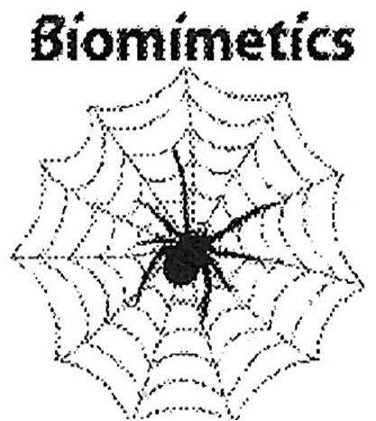

Biomimetics
Understanding biological principles
Relating current problems to natural philosophies
Mimicking natural ways
Improving existing technologies

Slide 18
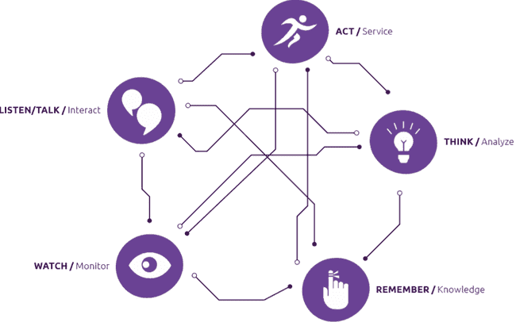
Challenging Orthodoxies
1.State a fact or assumption about your industry or problem
2.Ask yourself why the above is true? Should you challenge it?
3.Now answer, what would be the opposite of that assumption?
4.Create possibilities based off this new idea: 5 senses of automation:

Slide 19
Harnessing Trends
Knowledge is power! Study trends to seize opportunity early.
Yesterday is tomorrow today.
Spot trends by paying attention. Be a trend detective by noticing subtle changes in advertising and in products you see in the stores where you shop or on-line.
Build your knowledge base by studying what others say about what's coming. Read what the experts say then play with the results as they apply to what you do.
Tap into your intuition. What inklings do you have about changes in your industry, profession, or career?
Conduct your own research. Find out what your clients, customers or audience want by asking them. Ask your colleagues or co-workers. Go to the library or search on-line. The virtual world is way ahead of the three-dimensional world. What's going on there is a good indicator of what's to come
Ask big questions. When you see something new in the grocery store, ask yourself what trend it is tapping into. What is the manufacturer predicting? What does this mean? What does this mean for you and the way you work or do business? Where is the opportunity?

Slide 20
Leveraging Resources
Find out Resources and Capabilities
Tangible resources and capabilities are easily observable and quantifiable
Financial – the depth of a firm’s financial pockets
Physical – plants, offices, equipment, geographic locations and access to raw materials
Technological – skills and assets that generating leading edge products and services
Intangible resources are harder to quantify than tangible resources, but they must exist since no firm gains a competitive advantage through tangible resources alone
Human – the knowledge, trust and talents embedded within a firm that are not captured by its tangible systems and structures
Innovation – a firm’s assets and skills to research and develop new products and services
Reputational – a firm’s abilities to develop and leverage its reputation as a solid provider of goods/services, an attractive employer, and/or a socially responsible corporate citizen
Perform A value chain analysis shows how resources and capabilities come together to add value to a firm
The value chain consists of steps in the process of turning inputs to outputs. Value is added at each stage of the chain, from development to marketing. Each activity in the chain requires a number of resources and capabilities. Value chain analysis forces managers to think about resources and capabilities at a very micro, activity-based level
Rethink how we can utilize resources to fullest time, less down time, maximum output

Slide 21
4W + 2H & 5 Why Questions
Keep Asking Why and If you could not still get the desired Root Cause, then Ask 4 W and 2 H followed by 5 Whys to each one
What is done?
Who does the work?
Where is the work done?
When is the work done?
How is the work done?
How much is the work done?
?
Why should it be done
?
Why does he/she do it
?
Why should it be done here
?
Why should it be done this time
?
Why is it be done this way
?
Why is the count looking like this

Slide 22
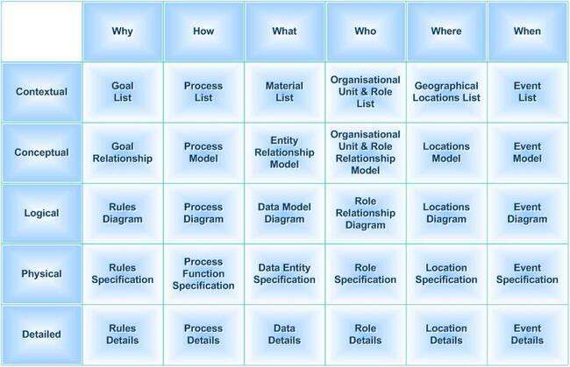
4W + H & 5 Why Look

Slide 23
7 old QC tools
Pareto and 80/20 rules
Fish-bone Causes and effect diagram
Histogram
Check-sheet techniques
Control Charts
Graphic presentation of data: Pie, Bar, Line, Radar, etc.
Correlation analysis: Scatter plot

Slide 24

7 New QC tools
Affinity Diagram
Relations Diagram
Tree Diagram
Arrow Diagram (e.g.: Prioritization Diagram)
Matrix Diagram (e.g.: Task Responsibility Diagram)
Process Decision Program Chart
Matrix Data Analysis (e.g.: Activity Network Diagram)
Notes:
Affinity Diagram : This tool takes large amounts of disorganized data and information and enables one to organize it into groupings based on natural relationships. It was created in the 1960s by Japanese anthropologist Jiro Kawakita. Its also known as KJ diagram, after Jiro Kawakita. Affinity diagram is a special kind of brainstorming tool.
Interrelationship Diagraph : This tool displays all the interrelated cause-and-effect relationships and factors involved in a complex problem and describes desired outcomes. The process of creating an interrelationship diagraph helps a group analyze the natural links between different aspects of a complex situation.
Tree Diagram : This tool is used to break down broad categories into finer and finer levels of detail. It can map levels of details of tasks that are required to accomplish a goal or task. It can be used to break down broad general subjects into finer and finer levels of detail. Developing the tree diagram helps one move their thinking from generalities to specifics.
Prioritization Matrix (Arrow Diagram) : This tool is used to prioritize items and describe them in terms of weighted criteria. It uses a combination of tree and matrix diagramming techniques to do a pair-wise evaluation of items and to narrow down options to the most desired or most effective.
Matrix Diagram : This tool shows the relationship between items. At each intersection a relationship is either absent or present. It then gives information about the relationship, such as its strength, the roles played by various individuals or measurements. For e.g.) Six differently shaped matrices are possible: L, T, Y, X, C, R and roof-shaped, depending on how many groups must be compared.
Process Decision Program Chart (PDPC) : A useful way of planning is to break down tasks into a hierarchy, using a Tree Diagram. The PDPC extends the tree diagram a couple of levels to identify risks and countermeasures for the bottom level tasks. Different shaped boxes are used to highlight risks and identify possible countermeasures (often shown as 'clouds' to indicate their uncertain nature). The PDPC is similar to the Failure Modes and Effects Analysis (FMEA) in that both identify risks, consequences of failure, and contingency actions; the FMEA also rates relative risk levels for each potential failure point.
Activity Network Diagram : This tool is used to plan the appropriate sequence or schedule for a set of tasks and related subtasks. It is used when subtasks must occur in parallel. The diagram enables one to determine the critical path (longest sequence of tasks).

Slide 25
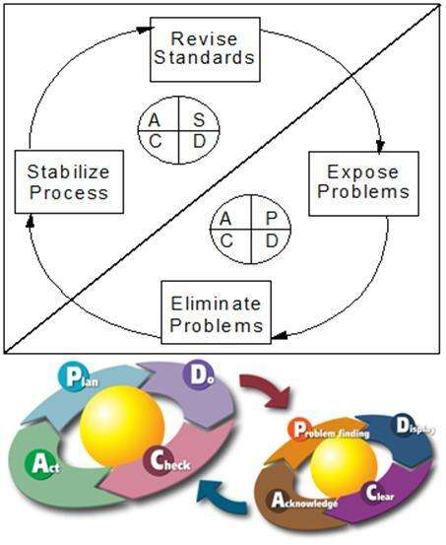

Cycle of ‘Continual’ Improvement
Kaizen follows a continual cycle of improvement by adopting changes not for perfection but to strive for Excellence
Change = Vision X Satisfaction X Action of quick first steps.
Degree of change is result of multiplying all factors. If any of factor is zero, change won’t happen
Business Agility = (Visibility + Motivation) x Training
S = Study the change, assure it is stable – then, improve again!
By changing your thinking,
You change your beliefs;
When you change your beliefs,
You change your expectations;
When you change your expectations,
You change your attitude;
When you change your attitude,
You change your behavior;
When you change your behavior,
You change your performance;
When you change your performance;
You Change Your Life!

Slide 26

To implement : Don’t Listen to Responses That Kill Creativity
“It can’t be done.”
“We’ve never done it.”
“Has anyone else tried it?”
“It won’t work in our department (company/industry).”
“It costs too much.”
“It isn’t in the budget.”
“Let’s form a committee.”
Notes:
1. I'm not enthusiastic, but it's no big deal to me. 2. I don't see it the way you do, but I may be wrong. 3. I don't agree, but I can live with it. 4. I don't agree, but I'll let you have your way. 5. I do not approve, and I need more time. 6. I strongly disapprove and cannot go along with it. 7. I will be so seriously upset I can't predict my reaction. 8. No possible way! If you do, I quit! 9. Over my dead body!

Slide 27
To Implement: Not to go with a story about Four people: Everybody, Somebody, Anybody and Nobody.
There was an important job to be done and Everybody was asked to do it. Everybody was sure Somebody would do it. Anybody could have done it, but Nobody did it.
Somebody got angry about that because it’s was Everybody’s job. Everybody thought Anybody could do it. But Nobody realized that Everybody wouldn’t do it.
It ended up that Everybody blamed Somebody when actually Nobody asked Anybody.

Slide 28
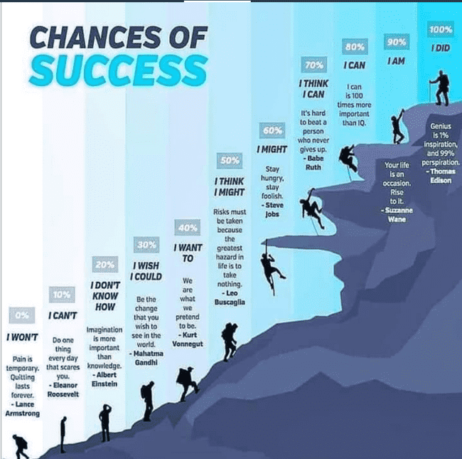
To Implement:

Slide 29
Leadership: Three Models To Implement
1. Old “Dictator” Style:
2. “Empowerment” Style:
3. “Lean” Style: Kaizen Recommended Leadership Model with a Process of having 6 Emotional Intelligences of 7 Habits of 5 Strategies in execution
“Do it my way…”
“Do it your way…”
“Follow me…and we’ll figure this out together as a Team by INVESTING INSPIRED SMARTER Purpose of 6 Characteristics to Align and Achieve 4 Dimensions of Quality Resulting to be in 8 Measures of Outcomes!”
Emotional Intelligence | Habits & Behaviors
1. Self Awareness | 1. Be Proactive: Responsibility/Initiative
2. Personal Motivation | 2. Begin with the End in Mind: Vision/Values
3. Self Regulation | 3. Put First Things First: Integrity/Execution
4. Social Skills | 4. Think Win-Win: Mutual Respect/Benefit 6. Synergize: Creative Cooperation
5. Empathy | 5. Seek First to Understand, Then to be Understood: Mutual Understanding
6. Continuous Seeking | 7. Sharpen The Say: Renewal
Notes:
1) Provide purpose and meaning to the vision
2) Always be authentic
3) Be accountable
4) Lead by example
5) Demonstrate a genuine passion for results
6) Learn from mistakes and bad news
7) Feed optimism with your actions

Slide 30
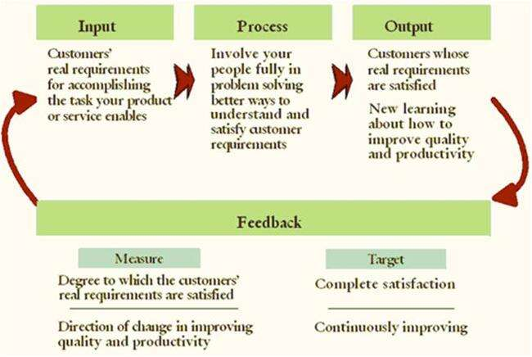
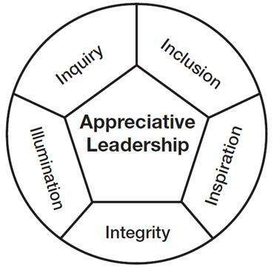
Summary Diagram To Implement Process with 5 Strategies of I in execution:
Inquiry - Ask positively powerful questions to Motivate and Enhance Trust
Illumination - Bring out best of people and situations keeping end in mind
Inclusion - Engage with people to coauthor future and company growth
Inspiration – Awaken creative spirit and all breakthroughs begin with belief in your self
Integrity - Make choices for good of whole adding values and You can't be all things to all people but illustrating “Coming together is a beginning. Keeping together is progress. Working together is success”
Notes:
The MBTI preferences indicate the differences in people based on the following:^{[4]}
How they focus their attention or get their energy (extraversion or introversion)
How they perceive or take in information (sensing or intuition)
How they prefer to make decisions (thinking or feeling)
How they orient themselves to the external world (judgment or perception)
By using their preference in each of these areas, people develop what Jung and Myers called psychological type. This underlying personality pattern results from the dynamic interaction of their four preferences, in conjunction with environmental influences and their own individual tendencies. People are likely to develop behaviors, skills, and attitudes based on their particular type. Each personality type has its own potential strengths as well as areas that offer opportunities for growth.
The MBTI tool consists of multiple choice questions that sort respondents on the basis of the four "dichotomies" (pairs of psychological opposites). Sixteen different outcomes are possible, each identified by its own four-letter code, referred to by initial letters. (N is used for iNtuition, since I is used for Introversion). The MBTI is approximately 75% accurate according to its own manual.^{[5]}
E – Extraversion preferred to introversion: ESTJs often feel motivated by their interaction with people. They tend to enjoy a wide circle of acquaintances, and they gain energy in social situations (whereas introverts expend energy).^{[6]}
S – Sensing preferred to intuition: ESTJs tend to be more concrete than abstract. They focus their attention on the details rather than the big picture, and on immediate realities rather than future possibilities.^{[7]}
T – Thinking preferred to feeling: ESTJs tend to value objective criteria above personal preference. When making decisions, they generally give more weight to logic than to social considerations.^{[8]}
J – Judgment preferred to perception: ESTJs tend to plan their activities and make decisions early. They derive a sense of control through predictability.^{[9]}
The MBTI preferences indicate the differences in people based on the following:^{[4]}
How they focus their attention or get their energy (extraversion or introversion)
How they perceive or take in information (sensing or intuition)
How they prefer to make decisions (thinking or feeling)
How they orient themselves to the external world (judgment or perception)
By using their preference in each of these areas, people develop what Jung and Myers called psychological type. This underlying personality pattern results from the dynamic interaction of their four preferences, in conjunction with environmental influences and their own individual tendencies. People are likely to develop behaviors, skills, and attitudes based on their particular type. Each personality type has its own potential strengths as well as areas that offer opportunities for growth.
The MBTI tool consists of multiple choice questions that sort respondents on the basis of the four "dichotomies" (pairs of psychological opposites). Sixteen different outcomes are possible, each identified by its own four-letter code, referred to by initial letters. (N is used for iNtuition, since I is used for Introversion). The MBTI is approximately 75% accurate according to its own manual.^{[5]}
I – Introversion preferred to extraversion: INFPs tend to be quiet and reserved. They generally prefer interacting with a few close friends rather than a wide circle of acquaintances, and they expend energy in social situations (whereas extraverts gain energy).^{[6]}
N – Intuition preferred to sensing: INFPs tend to be more abstract than concrete. They focus their attention on the big picture rather than the details, and on future possibilities rather than immediate realities.^{[7]}
F – Feeling preferred to thinking: INFPs tend to value personal considerations above objective criteria. When making decisions, they often give more weight to social implications than to logic.^{[8]}
P – Perception preferred to judgment: INFPs tend to withhold judgment and delay important decisions, preferring to "keep their options open" should circumstances change.^{[9]}

Slide 31
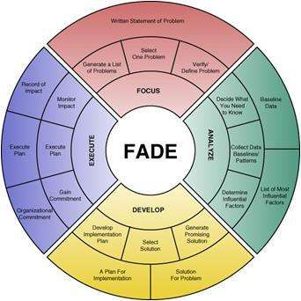
To Implement: Go with Following Attitude
We see change as a new challenge and opportunity to grow
We feel hopeful and optimistic and don't have the Victimitis Virus
Our leaders are authentic and provide good examples to follow
We operate with a high degree of honesty and integrity
We give each other regular feedback on personal actions and behavior
We continually seek feedbacks and improvements on making job easier
We have deep passion and commitment to our cause
We take pride in, and joy from, our work
We don’t have obstacles stopping performing to best effect
We persist in the face of setbacks and failures
We are self-disciplined
Our work is meaningful and makes a difference
We regularly devote time to learning and improvement
Our leaders are highly effective coaches who help us develop
We don't use threats, intimidation, or punishments
Rewards are used to recognize and share success rather than as incentives to manipulate performance
Our leaders have strong verbal communication skills
Our team has many cooperative partnerships, strong relationships, dividing task and multiplying success
We see motivation in every task
We frequently recognize, appreciate, and celebrate our small wins and significant successes
We move beyond our "reality rut" of current problems to focus on what could be
We know primary aim of our company - principles, priorities and mission
We have a strong and clear picture of our preferred future (vision)
We have 3 - 4 principles (core values) that guide our behavior (10 tags)
We take responsibility for our choices
Our goals are aligned to company goals
Our organization image is consistent with every customer as same as with internal team
We are involved in organization development
We have a strong sense of purpose
We feel empowered
Notes:
In order to achieve above Values, Individual needs to attain following Attitude:
I trust my intuition.
I welcome innovative ideas from employees
I feel comfortable asking employees' opinions and ideas on projects..
I am decisive. I do what I love and believe vision begin with end in mind
I Align team with the goals and vision of the company.
I believe the employee in the competence of management and their commitment to realize the goals and vision.
I Trust in their direct supervisor that he or she will support his or her people and help them to succeed.
I thrive on change and making effective.
I say no to 1000 things, but concentrate on what is necessary to take forward
If a person I am talking to seems ill-at-ease or intimidated, I will attempt to make him/her more comfortable (e.g. I will assume a different posture or tone of voice).
I state clearly the goals that everyone should be working towards.
I "roll with the punches" and adjust to changes in the business climate.
I am good at thinking "outside the box".
Once we have reached a goal, I set my sights on the next one for my organization.
I have a good sense of which employees/teams have the greatest potential in terms of helping the organization achieve its long-term objectives.
If one of my employees has an accident or makes a mistake, management must share some of the blame.
I believe in Whether or not a business is successful has a lot to do with chance.
Maintaining a good relationship with my employees is a top priority for me.
I feel that it is my job as manager/leader to ensure that each employee reaches his/her full potential.
I feel that I inspire my employees.
If I assign one of my tasks to someone else, I am not concerned that the person won't do as good of a job as I would. Managers/leaders must behave in a trustworthy manner to set an example for employees.
I demonstrate following things
a. Clarity of why you do what you do. To have this, you need a purpose, cause or belief that exists above and beyond the products or services you sell.
b. Discipline of how you do it. You must hold yourself and your people accountable to a defined set of guiding principles or values.
c. Consistency of what you do. Everything you say and do must prove what you believe. Every product that Apple made, all their marketing always communicated the same message: Think Different.
I Connect employees to the big picture. Helping an employee to understand a business's strategy and situation allows him or her to look and act beyond their role. When leaders at Radio Flyer, the Chicago-based maker of children's toys, wanted all 55 of its employees to better connect their individual efforts with the success of the company, they launched an initiative called "Connect-the-Dots" -- a three-part program geared toward educating employees about the business. One part consisted of an internal class, called "Wagon U 102: Driving Our Economic Engine," which discussed how the company defines and measures financial success. Radio Flyer executives also broadly communicated the five company objectives for the year along with related metrics for each department. Upward communication was jointly employed as each department reported its impact to the business back to fellow employees.
I Reward employees who go beyond "the norm." Nothing can quell people's desire to give extra than not feeling recognized. At Badger Mining Corp., a unique team approach ensures its 156 employees are rewarded for going above and beyond. Associates at this industrial mineral mining company belong to a "core" team, the one for which they were hired. In addition, they are encouraged to join cross functional teams, such as the "Retirement Plan Team," "Wellness Team" or "Safety Team." All teams are open to anyone interested in joining. Work on these teams becomes part of the performance evaluation process with employees gaining "extra credit" for joining and active participation.
I Make decisions and debates transparent. When employees have the full context about a decision and the options considered, they are more likely to support it regardless of whether they agree with it or not. At Bridgeway Capital Management, a Houston-based investment management firm that employs 33 people, leaders use an innovative meeting structure called "Fish-Bowl." The sessions are used to flesh out new proposals and educate staff on key decisions. A small group of employees sit in an inner circle to learn from one another on a controversial topic or idea. This group commits to "inquiry" on the subject as opposed to advocacy for or against the topic. Employees ask questions, explore the idea, flesh out any issues and learn about the subject. All remaining employees sit on the outside of the "fish bowl" and educate themselves on the idea while holding those on the inner circle accountable for listening, inquiring and being open and supportive to the new idea or issue. The result, they say, has been a quicker adoption of new and radical ideas.
I Collaborate on goals and decisions. A highly participative workplace yields better buy-in for decisions as people more fully support ideas they help create. Decision-making at Bridgeway often involves a combination of voting, consensus and/or delegating. For example, its human resources committee will design and recommend HR-related proposals, which will then go to the entire company for a vote. Depending on the magnitude of the decision, the vote will either be a super-majority vote (85 percent or more), a majority vote (50 percent or more) or a consensus driven decision in which objections are asked for but no formal vote is required. This shared decision-making extends to the company's annual goals as well. Using a unique process, all employees provide ideas for goals for the year. This list is then narrowed and ultimately voted upon by all employees, with each person having 100 points to vote for the top 10 goals. In the workplaces that have achieved a workforce of owner-minded employees, those workers often habitually step outside their role for the sake of the business's objectives. These cultures adapt faster to change and develop innovative ideas that lead to new product and market opportunities. And let's not forget they allow business owners to rest a little easier at night.
I DON'T get angry. "Getting angry is easy. Anyone can do that. But getting angry in the right way in the right amount at the right time, now that is hard." (Mark Twain) Anger does not belong in your managerial kit bag.
I DON'T be cold, distant, rude or unfriendly. Especially in difficult times, employees take cues from their immediate supervisors and need to hear from them. As such, your team will judge you by your action, moods, and behaviors, not by your intent.
I DON'T send mixed messages to your employees so that they never know where you stand. Keep your message simple, focused and prioritized. Too many messages and initiatives just confuse and alienate people.
I DON'T BS my team. This includes saying things that you don't believe in. This includes hiding information and just plain lying. By the time each of us is in our early 20's, we have all developed very well-tuned BS detectors.
I DON'T act more concerned about my own welfare than anything else. Your success will come through the success of your team."Self-serving detectors" are also very well-tuned in most employees.
I DON'T avoid taking responsibility for my actions. You are the boss. As such, you are accountable and the buck stops with you. You are trying to develop accountability throughout your company. So, lead by example.
I DON'T jump to conclusions without checking my facts first. A few years ago, I watched in horror as a colleague of mine started screaming at an employee of his who had missed an important meeting that morning. After several minutes, the employee responded: "I apologize and should have contacted you. But, I just got back from the hospital as my mother has been diagnosed with terminal cancer."
I DO what I say I am going to do when I am going to do it. There is no better way to communicate the message that you are accountable for your promises and that everyone in your company should be accountable as well.
I DO be responsive (return phone calls, emails). As a manager, your team can be considered to be your customer. You want your sales team to punctually respond back to customer requests, so you should do the same.
I DO publicly support your people. Your disagreements and disappointment with your employees can be communicated later and in private. Nothing appears so hollow as your attempt to blame your team for failures.
I DO admit my mistakes ... ...and take the blame for failures.
I DO recognize my team. "You can never underestimate the power of simple recognition for a job well done."
I DO ask and listen."The manager of the future will know how to ask rather than how to tell." (Peter Drucker) Some of the most dangerous words for a manager to ever say include: "But, you just don't understand…" "Because I said so…"
I DO smile and laugh. Have some fun. But, be genuine; programmed fun and faked laughter is worse than doing nothing. When appropriate, laugh at yourself; it will humanize you.
I understand the preferred communication style of the people I work closely with.
I connect with people on an emotional level when needed.
I share information about myself in order to deepen my connection with others.
I engage in conversations to create and explore new ideas and possibilities.
I brainstorm new ideas without judging or evaluating the idea too quickly.
I consider a variety of options and encourage others on my team to join me.
I develop clearly defined plans to meet my goals and objectives.
I verbalize to team members how we will accomplish a goal.
I have a system for tracking my progress on projects, goals, and initiatives.
When taking on new projects, I commit myself and demonstrate integrity by “walking my talk.”
I get team members engaged and committed to a common goal.
I know what I stand for, and the things I do are in line with that commitment.
I keep projects and tasks moving forward.
When momentum is not occurring, I check in with myself or my team to understand what action is needed to get back on track.
I am able to verbalize to team members what the next action is.
I am able to hold myself accountable.
I am able to hold others accountable.
I engage in conversations with others about the specific goals and expectations they are focused on.
When conflict arises, I have a conversation to address it in a timely, calm, and constructive fashion.
I do not fester in anger, bitterness, or resentment.
I am comfortable talking through differences in opinion and observations in order to resolve an issue.
When a situation seems to be in a repeat pattern or if things are not working, I have the conversations necessary to address the issue with the right people.
I catch myself when I am in circular thinking that is preventing me from reaching my goals.
When I am stuck or do not know what to do, I acknowledge it and ask the right people to help me through to the next step.
When a relationship is toxic or one-sided, I am able to have a conversation to disengage and withdraw.
When significant change is needed, I am able to describe the outcomes we are looking for.
I am self-aware and am able to navigate through my emotions surrounding a change situation.
When change has occurred, I am able to have a conversation to initiate or deal with the change.
When I sense a change is on the horizon, I am able to discuss proactively what items need to be considered in light of that future change.
I include other people appropriately so that they understand what is expected of them before, during, and after change initiatives
I regularly demonstrate my appreciation to others in ways that are tailored to them as individuals.
When others acknowledge me, I graciously accept their compliments.
I endorse others, and I am also well endorsed.
When a project is ending, I acknowledge the accomplishments.
When moving on from a team or organization, I leave on good terms and do not burn bridges.
When I or someone I know is leaving a team or an organization, I do something to acknowledge that a "chapter” is ending.
I Don’t assume but over-communicate
I stay calm but keep my team engaged
I know my obstacles and show team the progress of overcoming
I dole out credits instantaneously
I am authentic and at the same time I believe in my people with a strategy of Employees rarely quit companies. Instead, employees quit their managers or supervisors by leaving the company
I Create insanely different experiences
I allow myself to learn as well as mentor others to learn

Slide 32
Define INVESTING Purpose: 6 Characteristics
Break the Purpose to have INVESTING attributes
Independent, Negotiable, Vision-able, Estimable, Small, Testable, Imaginable, Nurturing, Get going
An effective Purpose Statement is to align the team with:
Imaginable and Learning
Conveys a clear picture of what the future will look like and gives environment to self learn. Development is a continuous learning process with additional challenge of teams and end product sizes
Meaningful and Find Meaning
Appeals to the long-term interests of all committed members to Specify and Focus on Value to Identify Value Stream and Allow value to flow without interruptions
Challenging and Liking
Comprises a realistic and attainable future with a “stretch”, Deliver as fast as possible, Shorter iterations is better the learning, feedback and communication within the team
Focused and Participating
Is clear enough to provide guidance in decision-making and involves in every task
Flexible and Be Positive
Is general enough to allow alternative responses in light of changing conditions, Decide as late as possible, delaying decisions as much as possible until they can be made based on facts and not on uncertain assumptions and predictions
Communicable and Be Open
Can be successfully explained in just a few minutes and be open enough to communicate from one level to another level and empowered to do their own job

Slide 33
Results – Product Quality
Character | Sub-characteristics | Attribute
Capability | Suitability | Presence and appropriateness of a set of functions for specified tasks.
 | Accurateness | Provision of right or agreed results or effects.
 | Interoperability | Its ability to interact with specified systems.
 | Compliance | Adhere to application related standards or conventions or regulations in laws and similar prescriptions.
 | Security | Its ability to prevent unauthorized access, whether accidental or deliberate, to programs or data.
Reliability | Maturity | Frequency of failure by faults in the product.
 | Fault tolerance | Its ability to maintain a specified level of performance in case of product faults or of infringement of its specified interface.
 | Recoverability | Capability to re-establish its level of performance and recover the data directly affected in case of a failure and on the time and effort needed for it.
Usability | Understandability | Users' effort for recognizing the logical concept and its applicability.
 | Learn ability | Users 'effort for learning its application.
 | Operability | Users 'effort for operation and operation control.
Efficiency | Time behavior | Response and processing times and on throughput rates in performances its function.
 | Resource behavior | Amount of resource used and the duration of such use in performing its function.
Maintainability | Analyzability | Effort needed for diagnosis of deficiencies or causes of failures, or for identification of parts to be modified.
 | Changeability | Effort needed for modification, fault removal or for environmental change.
 | Stability | Risk of unexpected effect of modifications.
 | Testability | Effort needed for validating the modified product.
Portability | Adaptability | Opportunity for its adaptation to different specified environments without applying other actions or means than those provided for this purpose for the product considered.
 | Install ability | Effort needed to install the product in a specified environment.
 | Conformance | Adhere to standards or conventions relating to portability.
 | Replace ability | Opportunity and effort using it in the place of specified other product in the environment of that product.
Notes:
12 Characteristics of Effective Metrics
Creating performance metrics is as much art as science. To guide you in your quest, here are 12 characteristics of effective performance metrics.
1. Strategic. To create effective performance metrics, you must start at the end point--with the goals, objectives or outcomes you want to achieve--and then work backwards. A good performance metric embodies a strategic objective. It is designed to help the organization monitor whether it is on track to achieve its goals. The sum of all performance metrics in organization (along with the objectives they support) tells the story of the organization’s strategy.
2. Simple. Performance metrics must be understandable. Employees must know what is being measured, how it is calculated, what the targets are, how incentives work, and, more importantly, what they can do to affect the outcome in a positive direction. Complex KPIs that consist of indexes, ratios, or multiple calculations are difficult to understand and, more importantly, not clearly actionable.
"We hold forums where we show field technicians how our repeat call metric works and how it might impact them. We then have the best technicians meet with others to discuss strategy and techniques that they use to positively influence the metric," says a director of customer management at an energy services provider.
3. Owned. Every performance metric needs an owner who is held accountable for its outcome. Some companies assign two or more owners to a metric to engender teamwork. Companies often embed these metrics into job descriptions and performance reviews. Without accountability, measures are meaningless.
4. Actionable. Metrics should be actionable. That is, if a metric trends downward, employees should know what corrective actions to take to improve performance. There is no purpose in measuring activity if users cannot change the outcome. Showing that sales are falling isn’t very actionable; showing that sales of a specific segment of customers is falling compared to others is more actionable.
Actionable metrics require employees who are empowered to take action. Managers must delegate sufficient authority to subordinates so they can make decisions on their own about how to address situations as they arise. This seems obvious, but many organizations hamstring workers by circumscribing the actions they can take to meet goals. Companies with hierarchical cultures often have difficulty here, especially when dealing with front-line workers whose actions they have historically scripted. These companies need to replace scripts with guidelines that give users more leeway to solve problems in their own novel ways.
5. Timely. Actionable metrics require timely data. Performance metrics must be updated frequently enough so the accountable individual or team can intervene to improve performance before it is too late. Some people argue that executives do not need actionable or timely information because they primarily make strategic decisions for which monthly updates are good enough. However, the most powerful change agent in an organization is a top executive armed with an actionable KPI.
6. Referenceable. For users to trust a performance metric, they must understand its origins. This means every metric should give users the option to view its metadata, including the name of the owner, the time the metric was last updated, how it was calculated, systems of origin, and so on. Most BI professionals have learned the hard way that if users don’t trust the data, they won’t use it. The same is true for performance metrics.
7. Accurate. It is difficult to create performance metrics that accurately measure an activity. Part of this stems from the underlying data, which often needs to be scanned for defects, standardized, deduped, and integrated before displaying to users. Poor systems data creates lousy performance metrics that users won’t trust. Garbage in, garbage out. Companies should avoid creating metrics when the condition of source data is suspect.
Accuracy is also hard to achieve because of the way metrics are calculated. For example, a company may see a jump in worker productivity, but the increase is due more to an uptick in inflation than internal performance improvements. This is because the company calculates worker productivity by dividing revenues by the total number of workers. Thus, a rise in the inflation rate, which artificially boosts revenues—which is the numerator in the metric—increases worker productivity even though workers did not become more efficient.
Also, it is easy to create metrics that do not accurately measure the intended objective. For example, many organizations struggle to find a metric to measure employee satisfaction or dissatisfaction. Some might ask users in surveys but it’s unclear whether employees will answer questions truthfully. Others might use the absenteeism rate but this might be skewed by employees who miss work to attend a funeral, care for sick family members, or stay home when daycare is unavailable.
8. Correlated. Performance metrics are designed to drive desired outcomes. Many organizations create performance metrics but never calculate the degree to which they influence the behaviors or outcomes they want. Companies must continually refresh performance metrics to ensure they drive the desired outcomes.
9. Game-proof. Organizations need to test all performance metrics to ensure that workers can’t circumvent them out of laziness or greed or go through the motions to make a red light turn green without making substantive changes. “Users always look for loopholes in your metrics,” says one BI manager. To prevent users from “fudging” customer satisfaction numbers, one company hires a market research firm to audit customer surveys.
10. Aligned. It’s important that performance metrics are aligned with corporate objectives and don’t unintentionally undermine each other, a phenomenon called “sub-optimization.” To align metrics, you need to devise them together in the context of an entire ecosystem designed to drive certain behaviors and avoid others.
11. Standardized. A big challenge in creating performance metrics is getting people to agree on the definitions of terms, such as sales, profits, or customer, that comprise most of the metrics. Standardizing terms is critical if organizations are going to distribute performance dashboards to different groups at multiple levels of the organization and roll up the results. Without standards, the organization risks spinning off multiple, inconsistent performance dashboards whose information cannot be easily reconciled.
12. Relevant. A performance metric has a natural life cycle. When first introduced, the performance metric energizes the workforce and performance improves. Over time, the metric loses its impact and must be refreshed, revised, or discarded.
"We usually see a tremendous upswing in performance when we first implement a scorecard application,” says a program manager at a major high tech company. “But after a while, performance trails off. In the end you can’t control people, so you have to continually reeducate them about the importance of the processes that the metrics are measuring or you have to change the processes."
Posted by Wayne W. Eckerson on April 19, 2010

Slide 34
Look for Results from all 4 Dimensions of Quality, not only from Product Quality
An effective Purpose of Work fulfills 4 Quality Dimensions
Product Quality
Not only working product, but also well-crafted product with ease of use, safety alerts and no waits at desired location anytime
Business Quality
Not only responding to change, but also steadily adding value and demonstrate to exceed expectations by Specifying and Focusing on Value to Identify Value Stream and Allowing value to Flow without interruptions
Professional Quality
Not only individuals and interactions, but also community of professionals to share knowledge across not only organization but also social community
Engagement Quality
Not only customer collaboration, but also productive partnerships in terms of engagement or relational quality focused on Let customer Pull value by demonstrating Continuously pursue of Perfection

Slide 35
Work Backward to get INSPIRED SMARTER Outcomes of 8 Measures. Again Start 3 MUs…
Eight Measures of Outcomes to look in for
Creativity (Leads to Unique Selling Points or Features)
Volume of Output
Satisfaction Level
Quality of Four Dimensions
Yield (Benefits to end user) from Products
Utilization of Resources
Speed of Turnaround (Cycle Time and Automation)
“Bottom-line” financial Profitability
Create tasks of INSPIRED
Internalized, Nurturing, Specific, Planned, In control, Reviewed Regularly, Energizing, Documented to refer
Set your SMARTER goal to achieve these visioning end in mind
SMARTER |  | C | Challenging
P | Positively stated | L | Legal
U | Understood | E | Environmentally sound
R | Repeatable | A | Agreed
E | Ethical | R | Recorded
Letter | Major Term | Minor Terms
S | Specific | Significant, Stretching, Simple, Stimulating, Succinct, Straight forward, Self controlled, Strategic, Sensible, Sustainable
M | Measurable | Meaningful, Motivational, Manageable, Maintainable, Mapped to goals
A | Attainable | Appropriate, Achievable, Agreed, Assignable, Actionable, Ambitious, Aligned, Aspired, Ambitious, Acceptable, Aligned, Accountable, As-if-now, Adjustable, Adaptable
R | Relevant | Realistic, Resourced, Resonant, Results Orientated, Recordable, Reviewable, Robust
T | Time-bound | Time-oriented, Time framed, Timed, Time-based, Time boxed, Timely, Time-Specific, Timetabled, Time limited, Track-able, Tangible, Towards goal, Team Together
E | Empowering | Engaging, Evaluate, Ethical, Excitable, Enjoyable, Energizing, Encompassing, Extendable
R | Reevaluate | Rewarded, Reassess, Revisit, Rewarding, Reaching, Researching, Re-Assuring, Recursive

Slide 36
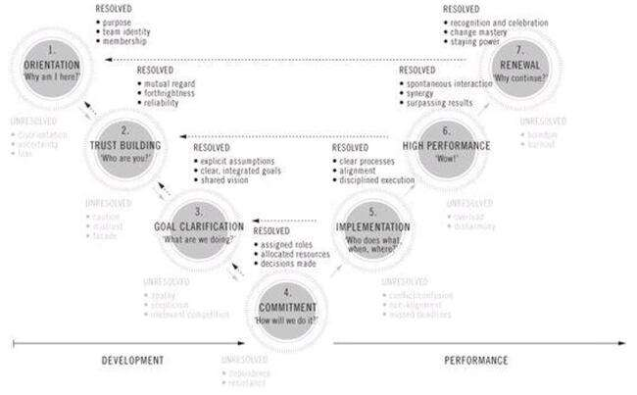
Convert Group to Team by following Method

Slide 37
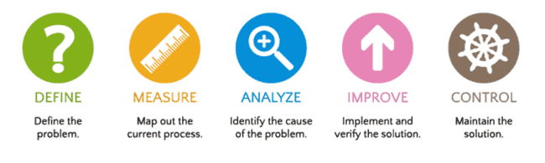
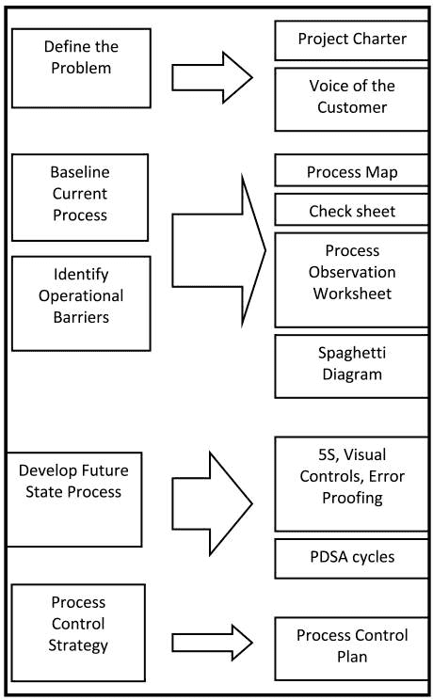
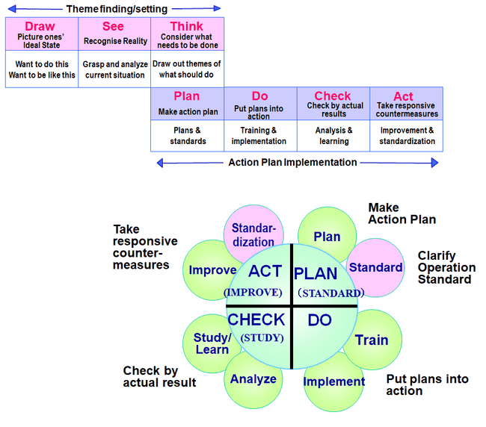
6 sigma

Slide 38
Comparative Analysis 6 sigma vs. Kaizen
5s
6s
Improvement Methodologies
Similar in Structure
Improvements measured against established process
Team oriented
Similar improvement tools
Measure effectiveness of improvements
Maintain new performance level
Standardize & Proceduralize
Results
More Efficient Processes
Comparison
Both are Effective Improvement Mechanisms
CPI/6s best applied to large complex problems
Kaizen/Lean best applied to achieve incremental changes and eliminate wastes.
Kaizen/Lean
Measure
- Data Collection
- Determine Process Potential / Goals
Evaluate
- Root Cause / Vital Few
- Statistical Analysis
Improve & Verify
- Implement Improvement
- Validate Improvement
Standardize
- Standardize / Leverage
- SPC
- Update Procedures
Evaluate
- Baseline Process Performance
- Establish Target
Decide
-Compare solutions
- Choose
Act
-Communicate
- Implement improvement
- Control
Measure
- Validate improvement
- Standardize
- Update Procedures
Focus
- Reduce Process Variation
- Identify Critical Cause and Focus Resources for Maximum Impact
Focus
Team to come with Ideas of 5S to have 9 categories
- Seek Incremental Process Changes
Summary
- Technical Approach based on Statistical Analysis
- Requires Significant Data Collection
- Best applied to Manufacturing Processes
- Typical Projects 1-3 Months
Summary
- Common Sense Approach based on Observation
- Applicable to all types of processes
- Defined improvement strategy
- Typical Projects 1 week
When companies implemented lean management, the average gains in productivity were around 25%, wastages were reduced by even 90%, space, workload shrunk by 50%, and travel distances , approvals inside the organizations were cut down by 75%.
Notes:
Another comparative analysis showing the major steps in each of a Six Sigma and a Kaizen Program and that the primary focus of 5S is process related i.e. not only to the processes of cleaning, organizing etc. associated wtih5S, but also the work processes of documentation, selling, purchasing, manufacturing, distribution and integration of these with5S processes.

Slide 39
Benefits of a Kaizen
Teamwork
Everyone is able to participate and make improvements
No one individual, but a team, make the improvements
Motivation
Achievement, Recognition, The Work Itself, Responsibility, and Advancement
Communication
Improved relations between associates and management
Education
Improved problem solving
The more you teach someone to fish the more than can feed themselves
Awareness
Understanding of broad issues and objectives of the organization as a whole
Better understanding of Continuous Improvement and the challenges involved with Change
Confidence
Stronger feelings of self-worth

Slide 40
Benefits of a Kaizen
Achieved Quality Results of Outcomes with SMARTER Measurements
Creativity that leads to Unique Selling Points or Features
Volume of Output
Satisfaction Level
Quality of Four Dimensions
Yield (Benefits to end user) from Products
Utilization of Resources
Speed of Turnaround (Cycle Time and Automation)
“Bottom-line” financial Profitability
Engaged Empower-able Involvement
Increased control over the job and work environment which fosters ownership and commitment to the change process
All employees now should feel
they have a voice in the process!
Notes:
Time is Now.
Take Time to Work - it is the price of success.
Take Time to Think - it is the source of power.
Take Time to Play - it is the secret of youth.
Take Time to Read - it is the foundation of wisdom.
Take Time to be Friendly - it is the road to happiness.
Take Time to Dream - it is hitching your wagon to a star.
Take Time to Love and be Loved - it is the privilege of God.
Take Time to Look Around - it is too short a day to be selfish.
Take Time to Laugh - it is magic of the soul.
The Value of Time
To realize the value of ONE YEAR, ask a student who failed a grade.
To realize the value of ONE MONTH, ask a mother who gave birth to a premature baby.
To realize the value of ONE WEEK, ask the editor of a weekly newspaper.
To realize the value of ONE HOUR, ask the lovers who are waiting to meet.
To realize the value of ONE MINUTE, ask a person who missed the train.
To realize the value of ONE SECOND, ask a person who just avoided an accident.
To realize the value of ONE MILLISECOND, ask the person who won a silver medal (instead of Gold) in the Olympics.
To realize the value of ONE MICRO SECOND, ask the software developer who works on performance tuning
To realize the value of ONE NANO SECOND, ask the scientist who works on cell replications

Slide 41
Summary
3 MUs
5 S Application
9 Areas of Identification
11 Methods of Creativity Exploration for Innovation
3 Implementation Models with 6 Emotional Intelligences of 7 Habits and by executing 5 Strategies of I
6 Characteristics of INVESTING SMARTER INSPIRED Purposes to Align as a Team from Group
4 Dimensions of Quality Results Achievement
8 Measures of Outcomes to Look
Identify 3 MU items to each 9 Areas by applying every 5 S
Adopt suitable 11 Methods of exploration not only to identify those items , but also to get action items to each identified items
Finally Implement Lean Model to execute those action items by executing 5 Strategies of I with 6 Emotional Intelligences of 7 Habits INVESTING 6 characteristics of INSPIRED SMARTER purposes to align as a team and to achieve 4 Dimensions of Quality results to look in for 8 Measures of Outcomes.
Continually do the above activities again and again

Slide 42
Questions and Answers
?
?
?
Notes:
People are unreasonable, illogical, and self-centered. Work with them anyway. If you do good, people may accuse you of selfish motives. Do good anyway. If you are successful, you may win false friends and true enemies. Succeed anyway. The good you do today may be forgotten tomorrow. Do good anyway. Honesty and transparency make you vulnerable. Be honest and transparent anyway. What you spend years building may be destroyed overnight. Build anyway. People who really want help may attack you if you help them. Help them anyway. Give the world the best you have and you may get hurt. Give the world your best anyway.

